Slide 1


TÍMI 1
Ég get kannað þema ársins, UPPGRÖFTUR / UNEARTHED, og kynnst öllum í liðinu mínu.
Ég get unnið með liðinu við að kubba þrautirnar og byrjað að fá hugmyndir með því að skoða myndasögu og hugmyndakveikjur.
Nemendur kynnast, kubba þrautirnar og skoða myndasöguna og hugmyndakveikjur

Slide 2
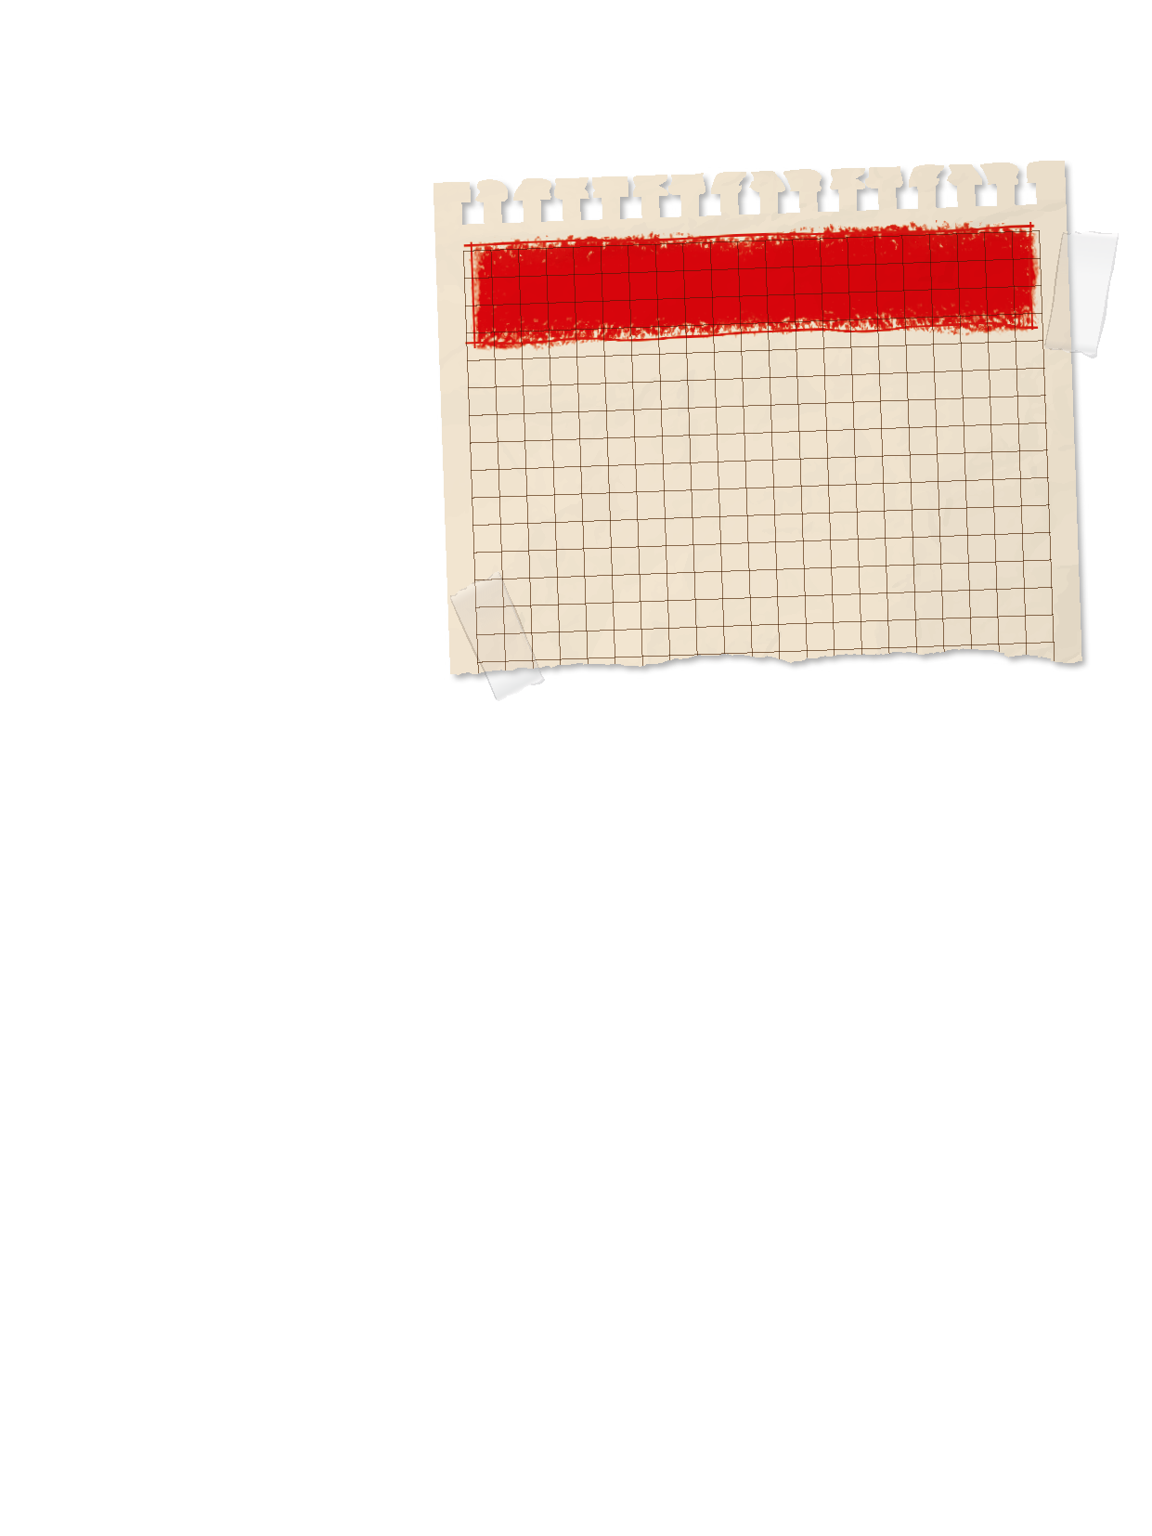

Kynning
Liðið kynnist.
Skráðu upplýsingar um liðið hér
Hvað heitir liðið?
Notes:
Kynning:
- Kynntu þér liðsmenn þína og veldu liðsnafnið þitt.
Horfðu á First Lego League myndbönd og lestu síður 3-9 til að læra hvernig FIRST® LEGO® League Challenge virkar og um UNEARTHEDTM vélmennakappeikinn og nýsköpunarverkefnið.
Ábendingar:
- Láttu liðið horfa á myndbönd tímabilsins á FIRST® LEGO® League YouTube rásinni og lesa blaðsíður 3-9 í verkefnahandbókunum sínum.

Slide 3
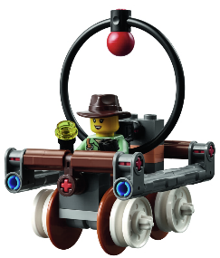

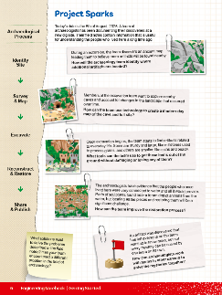
Orðalisti
þrautir: LEGO líkön sem sett eru á þrautabrautina, hönnuð til að tákna raunveruleg hugtök eða áskoranir.
hugmyndakveikjur: kveikjur sem aðstoða liðið við að velja sér vandamál til að leysa í nýsköpunarverkefninu
nýsköpunarverkefni: Finna og kanna ákveðna áskorun/vandamál og þróa lausn
Notes:
Session specific vocab

Slide 4

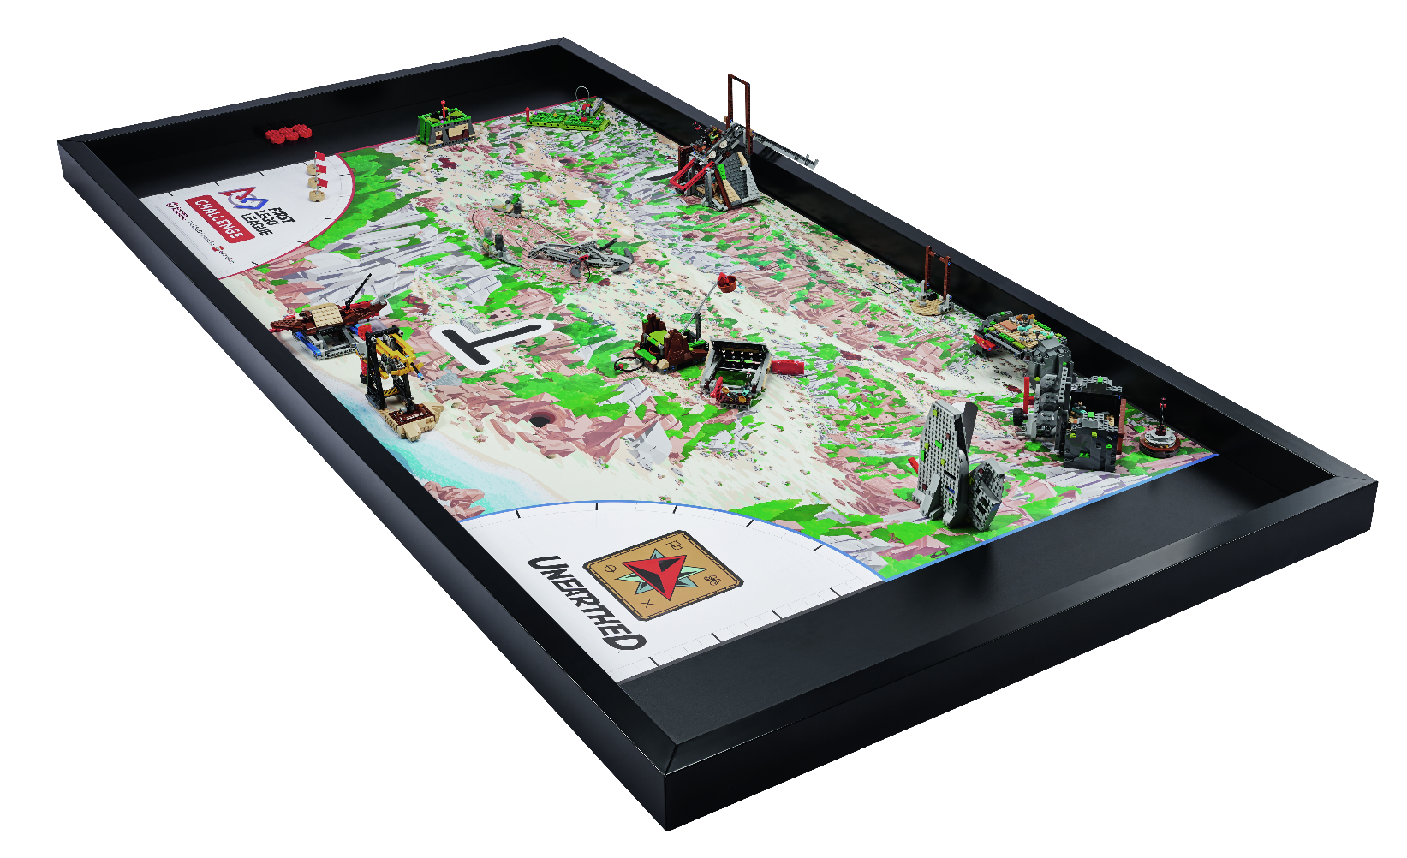
Verkefni
Kubbið þrautir fyrir vélmennakappleikinn
Festið líkönin á þrautabrautina (dúkinn)
Á bls. 7-8 í reglubók vélmennakappleiksins er sýnt hvernig á að setja upp keppnisborðið
Notes:
Tasks ​
Learn more about the season theme by building the robot game mission models.
Place each model where it belongs on the Challenge mat. Read page 7 of the Robot Game Rulebook to learn how to set up the table.
Explore how the models work. Connect them to the Project Sparks on page 6.
Use the space on this page to write notes about the mission models or to answer the reflection questions.
​
Session Tips​
Provide the model building instructions and show the field setup video to the team.
The team can work together or as individuals to build the models. Be sure to inspect and test the models to ensure they function correctly. Use the Robot Game Rulebook and mission video to understand how the models work.
Encourage the team to investigate the mat and the mission models to inspire them. The team should record ideas for possible innovation project problems.

Slide 5

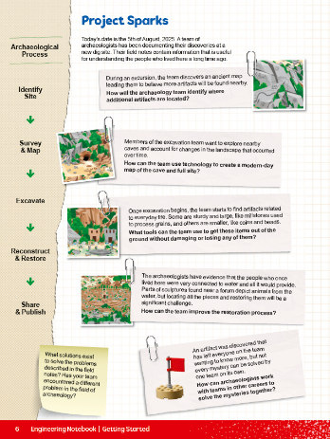
Verkefni
Kannið hvernig þrautirnar virka.
Tengið þær við hugmyndakveikjurnar
Hugmyndakveikjur er á bls. 6 í verkefnahandbókinni
Notes:
Tasks ​
Learn more about the season theme by building the robot game mission models.
Place each model where it belongs on the Challenge mat. Read page 7 of the Robot Game Rulebook to learn how to set up the table.
Explore how the models work. Connect them to the Project Sparks on page 6.
Use the space on this page to write notes about the mission models or to answer the reflection questions.
​
Session Tips​
Provide the model building instructions and show the field setup video to the team.
The team can work together or as individuals to build the models. Be sure to inspect and test the models to ensure they function correctly. Use the Robot Game Rulebook and mission video to understand how the models work.
Encourage the team to investigate the mat and the mission models to inspire them. The team should record ideas for possible innovation project problems.

Slide 6


Verkefni
Skráið hjá ykkur athugasemdir um þrautirnar á bls. 10 í verkefnahandbókinni
Svarið ígrundunarspurningum
Hugmyndakveikjur er á bls. 6 í verkefnahandbókinni
Notes:
Tasks ​
Learn more about the season theme by building the robot game mission models.
Place each model where it belongs on the Challenge mat. Read page 7 of the Robot Game Rulebook to learn how to set up the table.
Explore how the models work. Connect them to the Project Sparks on page 6.
Use the space on this page to write notes about the mission models or to answer the reflection questions.
​
Session Tips​
Provide the model building instructions and show the field setup video to the team.
The team can work together or as individuals to build the models. Be sure to inspect and test the models to ensure they function correctly. Use the Robot Game Rulebook and mission video to understand how the models work.
Encourage the team to investigate the mat and the mission models to inspire them. The team should record ideas for possible innovation project problems.

Slide 7

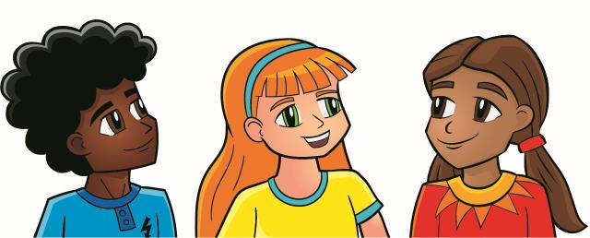
Ígrundun
Hvaða hugmyndir hefur liðið fengið eftir að hafa kynnt sér nýsköpunarverkefnið?
Hvernig tengjast þrautirnar myndasögunni og hugmyndakveikjunum?
Hvaða þrautir finnst ykkur mest spennandi?

Slide 8




Deilið
Hvernig tengjast þrautirnar á þrautabrautinni þema árins, UPPGRÖFTUR / UNEARTHEDTM?
Notes:
Share ​
Discuss the reflection questions
Get together at the mat. Talk about how the mission models connect to the UNEARTHED theme.
Clean up your space.
​
Session Tips​
Lead a discussion about the Project Sparks and Challenge story and how they relate to the mission models.

Slide 9
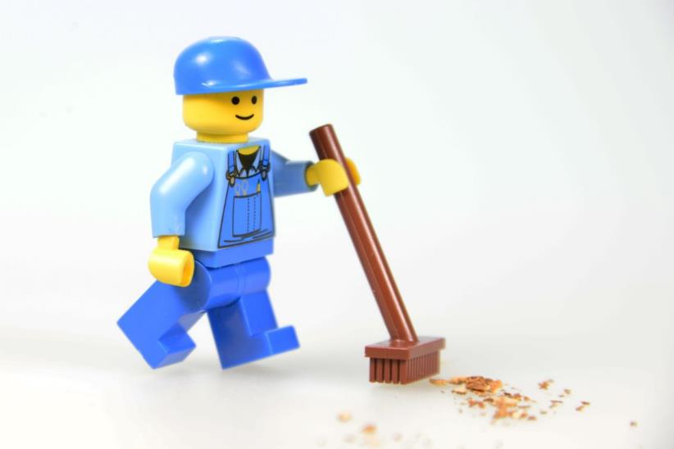
Takið til á vinnusvæðinu

Slide 10


LEGO, the LEGO logo, and the SPIKE logo are trademarks of the/sont des marques de commerce du/son marcas registradas de LEGO Group. ©2025 The LEGO Group. All rights reserved/Tous droits réservés/Todos los derechos reservados. FIRST®, the FIRST® logo, and FIRST® AGE™ are trademarks of For Inspiration and Recognition of Science and Technology (FIRST). LEGO® is a registered trademark of the LEGO Group. FIRST® LEGO® League and UNEARTHED™ are jointly held trademarks of FIRST and the LEGO Group. ©2025 FIRST and the LEGO Group. All rights reserved.

