Slide 1


TÍMI 12
Ég get unnið með teyminu mínu að því að æfa kynningar okkar fyrir nýsköpunarverkefnið okkar og hönnun og forritun vélmennis.
Ég get unnið með teyminu mínu í því að æfa vélmennakappleiki.
Nemendur æfa kynningar og vélmennakappleikinn til að undirbúa sig fyrir keppnisdaginn. ​

Slide 2

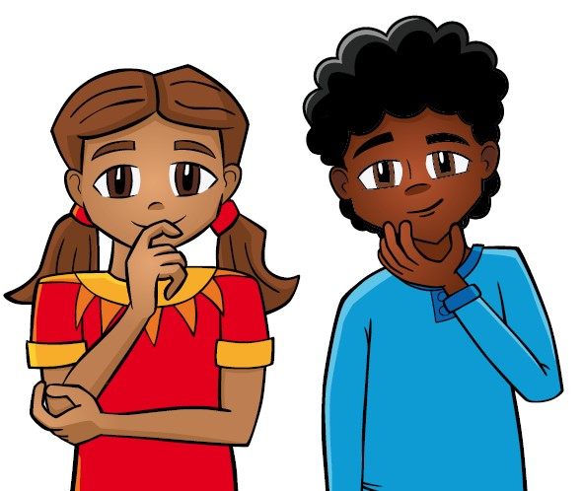
Umræður
Hvað lærðum við í síðasta tíma
Notes:
Discuss with students the progress made on their presentations for robot design and innovation project in the previous session. ​​

Slide 3

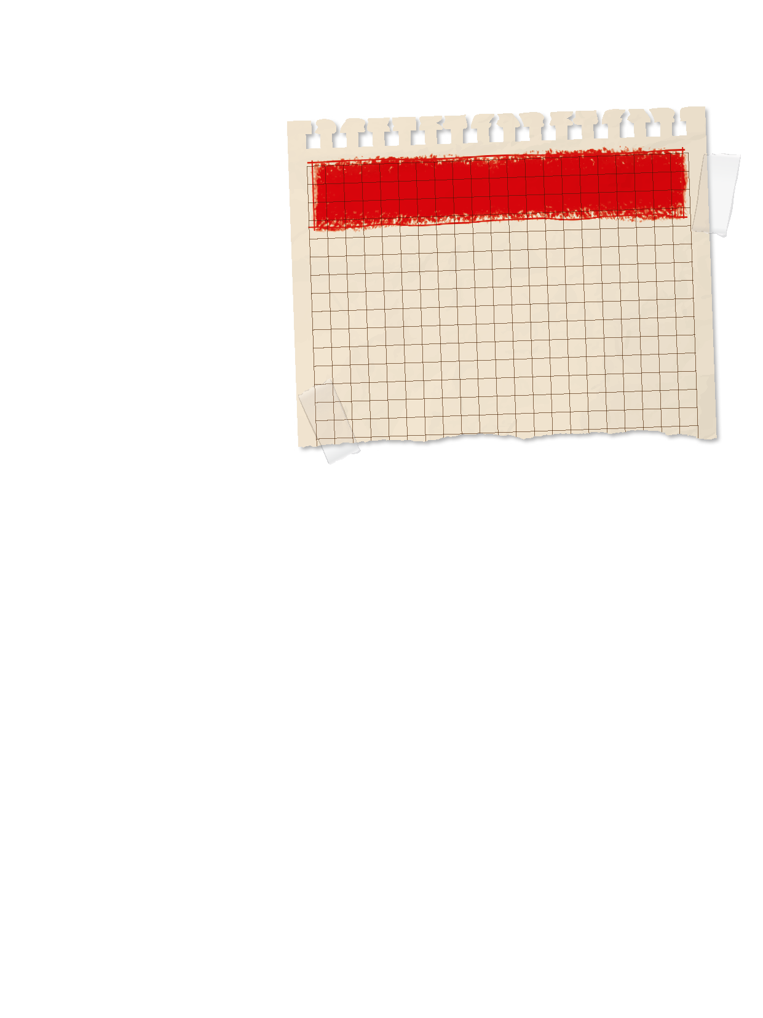
Introduction
Skemmtun: Við höfum gaman saman og fögnum því sem við gerum.
Nefnið nokkur dæmi um það hvernig þið skemmtuð ykkur á tímabilinu?
Lítið til baka á markmið liðsins á blaðsíðu 8 í verkefnahandbókinni.
Náðuð þið þessum markmiðum?
Notes:
Introduction:
Reflect on how your team has had fun while exploring the season theme. Talk about examples of how your team has had fun throughout this experience.
Look at your team’s goals listed on page 8. Did you achieve them?
Session Tips:
Try to split the time in this session equally between rehearsing the presentation and practicing the matches.
Encourage the team to practice their presentation before the event. They can practice by sharing their solutions with others. The judging session flowchart tells you how much time is allowed for the presentation.

Slide 4


Verkefni
Æfið báðar kynningarnar; nýsköpunarverkefnið og hönnun og forritun vélmennis.
Fáið endurgjöf frá leiðbeinandanum eða öðru teymi.
Notes:
Tasks ​
Rehearse your full presentation communicating your innovation project and robot design work.
Collect feedback on your presentation from your coach, a mentor, or another team.
Practice multiple 2.5-minute robot game matches and calculate the points you score.
Review page 26, Prepare for Your Event, and page 27, Rubrics & Scoresheets.
Session Tips​
Have the team run their 2.5-minute robot matches. Make sure they practice running their programs in the right order.
The team should have a contingency plan for if things don’t go as planned during the robot game.
They could identify other missions to run. Remind the team about the Core Values and how they will show them throughout the event, including at every robot game match.

Slide 5

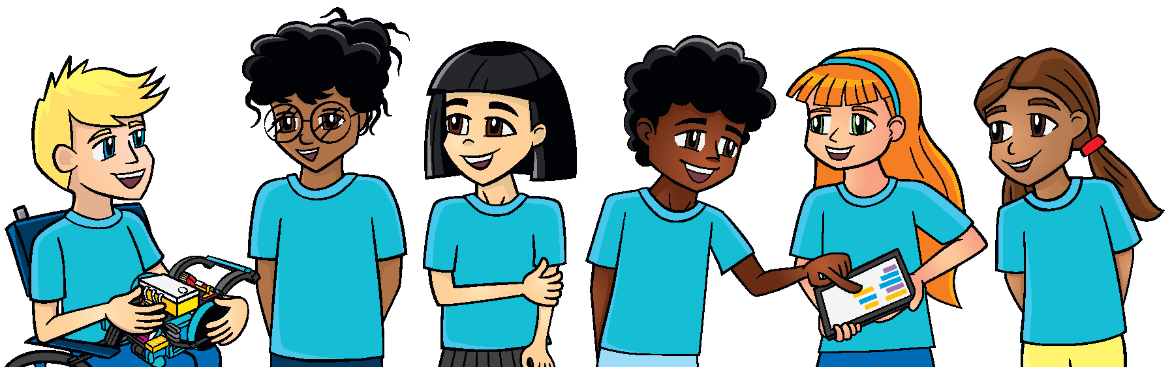
Verkefni
Æfið marga 2 mín og 30 sek vélmennakappleiki.
Notið stigagjöfina sem þið finnið á heimasíðu FLL og vísað er í á bls.27 í verkefnahandbókinni til að reikna út stigin sem þið skorið.
Notes:
Tasks ​
Rehearse your full presentation communicating your innovation project and robot design work.
Collect feedback on your presentation from your coach, a mentor, or another team.
Practice multiple 2.5-minute robot game matches and calculate the points you score.
Review page 26, Prepare for Your Event, and page 27, Rubrics & Scoresheets.
Session Tips​
Have the team run their 2.5-minute robot matches. Make sure they practice running their programs in the right order.
The team should have a contingency plan for if things don’t go as planned during the robot game.
They could identify other missions to run. Remind the team about the Core Values and how they will show them throughout the event, including at every robot game match.

Slide 6
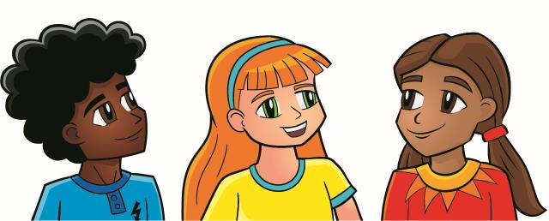
Ígrundun
Hver er áætlun ykkar um að hafa viðbætur vélmennisins tilbúnar fyrir vélmennakappleikinn?
Hverju hefur liðið áorkað?

Slide 7




Deilið
Æfið ykkur í að kynna nýsköpunarverkefnið og hönnun og forritun vélmennis.
Notes:
Share ​
Discuss the reflection questions.
Review the judging rubrics and robot game scoresheet.
Practice presenting your project and robot design explanation.
Clean up your space​

Slide 8
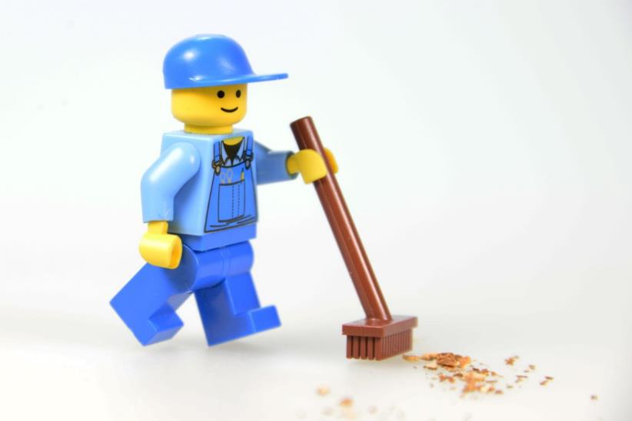
Takið til á vinnusvæðinu

Slide 9


LEGO, the LEGO logo, and the SPIKE logo are trademarks of the/sont des marques de commerce du/son marcas registradas de LEGO Group. ©2025 The LEGO Group. All rights reserved/Tous droits réservés/Todos los derechos reservados. FIRST®, the FIRST® logo, and FIRST® AGE™ are trademarks of For Inspiration and Recognition of Science and Technology (FIRST). LEGO® is a registered trademark of the LEGO Group. FIRST® LEGO® League and UNEARTHED™ are jointly held trademarks of FIRST and the LEGO Group. ©2025 FIRST and the LEGO Group. All rights reserved.

