Slide 1


TÍMI 2
Ég get unnið með liðinu mínu við að byggja grunn að vélmenninu og forrita það til að keyra fram, aftur og snúa við.
Ég get unnið með liðinu mínu að því að kanna og rannsaka hugmyndir fyrir nýsköpunarverkefnið.
Nemendur læra að hanna og forrita vélmennið og byrja að huga að því hvernig þrautirnar á þrautabrautinni tengjast nýsköpunarverkefninu.

Slide 2


Umræður
Hvað gerðum við í síðasta tíma?
Notes:
Discuss with students the different mission models they built, and the Project Sparks from last session. ​​

Slide 3


Kynning
Könnunarleiðangur: Við könnum nýja færni og hugmyndir.
Skráið hvað þið ætlið að kanna á ferðalagi ykkar.
Skráið á bls.8 í verkefnahandbókinni hvaða markmið liðið hefur og hvað þið vonist til að læra á ferðalaginu ykkar.
Notes:
Introduction:
• Think about how you will use the Core Value of discovery in your team’s journey.
• Record what your goals are and what you hope to learn on the Team Progress sheet on page 8.
Session Tips:
Teams will explore the six Core Values throughout their season.

Slide 4
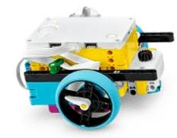


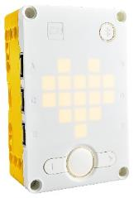
Orðalisti
vélmenni: stjórnkubbur og allur áfastur búnaður tengdur honum
kóði: forritaðar leiðbeiningar
stjórnkubbur: eining sem keyrir forritin fyrir vélmennið
Notes:
Session specific vocab

Slide 5


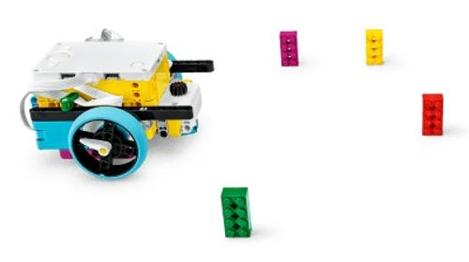
Verkefni
Ljúkið eftirfarandi kennslustundum í SPIKETM appinu
Kennsluverkefni 1-6 (valfrjálst) Competition Ready Unit Æfingabúðir 1: Að keyra um
Notes:
Tasks ​
Open the SPIKE App/ Click the Start button.
Find your Lesson.
Tutorial Activities (1-6 (optional)
Competition Ready Unit Training Camp 1: Driving Around
Use the skills you learned to navigate your robot to one of the mission models
Determine what coding and building skills you can apply in the robot game. Use the notes section to record your ideas.
As you navigate around the mat, talk with your team about any innovation project ideas sparked by the mission models.
​
Session Tips​
The Tutorial Activities are optional but recommended if your team has minimal coding and building experience.
After a program is downloaded onto the controller, it cannot be transferred back to be opened and edited.

Slide 6
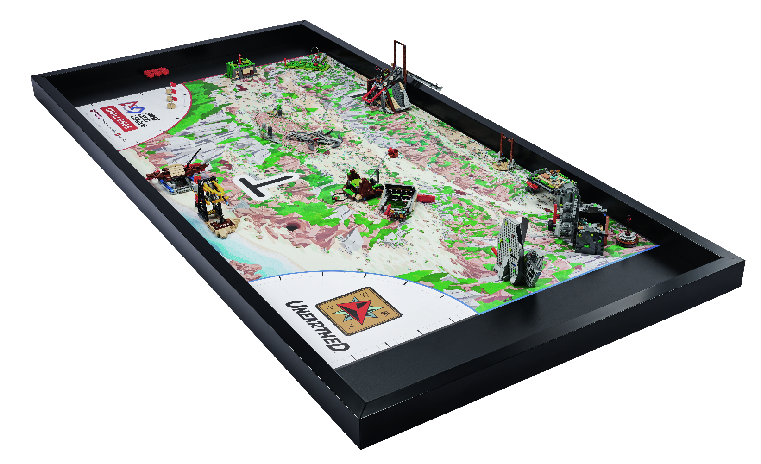
Verkefni
Stýrðu vélmenninu að einni af þrautunum á þrautabrautinni
Skrifaðu minnispunkta um hvaða forritunar- og smíðatækni þú hefur lært og getur notað í vélmennakappleiknum.
Notes:
Tasks ​
Open the SPIKE App/ Click the Start button.
Find your Lesson.
Tutorial Activities (1-6 (optional)
Competition Ready Unit Training Camp 1: Driving Around
Use the skills you learned to navigate your robot to one of the mission models
Determine what coding and building skills you can apply in the robot game. Use the notes section to record your ideas.
As you navigate around the mat, talk with your team about any innovation project ideas sparked by the mission models.
​
Session Tips​
The Tutorial Activities are optional but recommended if your team has minimal coding and building experience.
After a program is downloaded onto the controller, it cannot be transferred back to be opened and edited.

Slide 7

Verkefni
Liðið ræðir allar þær hugmyndir að nýsköpunarverkefni sem vakna og tengjast þrautabrautinni.
Notes:
Tasks ​
Open the SPIKE App/ Click the Start button.
Find your Lesson.
Tutorial Activities (1-6 (optional)
Competition Ready Unit Training Camp 1: Driving Around
Use the skills you learned to navigate your robot to one of the mission models
Determine what coding and building skills you can apply in the robot game. Use the notes section to record your ideas.
As you navigate around the mat, talk with your team about any innovation project ideas sparked by the mission models.
​
Session Tips​
The Tutorial Activities are optional but recommended if your team has minimal coding and building experience.
After a program is downloaded onto the controller, it cannot be transferred back to be opened and edited.

Slide 8

Ígrundun
Hvernig getur það hjálpað liðinu í vélmennakappleiknum að miða vélmenninu að einni af þrautunum?
Hvaða hugmyndakveikjur vekja áhuga hjá liðinu?
Vill liðið kanna einhverjar aðrar áskoranir / vandamál?
Notes:
Session Tips:
The team should reference the innovation project page and begin identifying problems. The team will need to have their problem statement finalized by Session 3.

Slide 9




Deilið
Hvað lærðuð þið um vélmennið í þessum tíma?
Notes:
Share ​
Discuss the reflection questions
Get together at the mat. Share the robot skills you learned in this session.
Clean up your space.
​
Session Tips​
Have the team practice their new skills by trying to drive the robot to a model and return to home..

Slide 10

Takið til á vinnusvæðinu

Slide 11


LEGO, the LEGO logo, and the SPIKE logo are trademarks of the/sont des marques de commerce du/son marcas registradas de LEGO Group. ©2025 The LEGO Group. All rights reserved/Tous droits réservés/Todos los derechos reservados. FIRST®, the FIRST® logo, and FIRST® AGE™ are trademarks of For Inspiration and Recognition of Science and Technology (FIRST). LEGO® is a registered trademark of the LEGO Group. FIRST® LEGO® League and UNEARTHED™ are jointly held trademarks of FIRST and the LEGO Group. ©2025 FIRST and the LEGO Group. All rights reserved.

