Slide 1


TÍMI 3
Ég get í samvinnu við lið mitt fundið ákorun / vandamál sem okkur langar að rannsaka og þróa lausnir á í nýsköpunarverkefninu okkar.
Ég get í samvinnu við lið mitt forritað vélmennið til hreyfa viðbætur og forðast hindranir með skynjurum.
Nemendur byrja á nýsköpunarverkefninu og halda áfram að hanna og forrita vélmennið.

Slide 2


Umræða
Hvað gerðum við í síðasta tíma?
Notes:
Discuss with students the coding and building skills they learned last session and ask them what innovation project ideas interest them. ​​

Slide 3


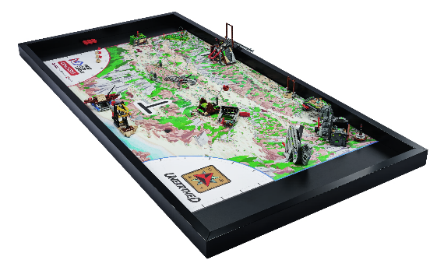
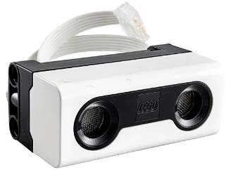
Orðalisti
rannsókn: söfnun upplýsinga um tiltekið viðfangsefni
vélmennakappleikur: vélmenni leysir þrautir í 2,5 mínútna kappleik
skynjari: tæki sem skynjar eitthvað og bregst við með því að senda merki
Notes:
Session specific vocab

Slide 4


Kynning
Farið yfir hugmyndakveikjurnar
Hugmyndir og kveikjur:
Deildu hugmyndum þínum með liðinu.
Passið að allir fái tækifæri til að deila sínum hugmyndum.
Notes:
Introduction:
Review the innovation project page and the Project Sparks.
Share your ideas for the project with your team. Make sure everyone has a chance to share.
Session Tips:
If your team has already agreed on the focus of their project, encourage them to begin researching the topic. You can find helpful resources on the Season Resource page.
While the team might not choose every member’s preferred problem, they should choose something everyone supports.
The team will write their problem statement on page 12 of their Engineering Notebook. Remember, they can choose one of the problems from the Project Sparks if they are unable to come up with their own idea. If the team has multiple ideas, they could use a voting process to narrow it down to one.

Slide 5

Verkefni
Lýsing á vandamáli:
Lýsið áskoruninni / vandamálinu sem þið ætlið að takast á við
Notes:
Tasks ​
Record your team’s problem statement.
Open the SPIKE™ app. Find your lesson.
Competition Ready Unit Training Camp 2: Playing with Objects
Reflect on the skills you learned in this unit. Talk about how they will help you in the robot game.
Try it out! See if you can code your robot to attempt a mission.​
Session Tips​
The Tutorial Activities are optional but recommended if your team has minimal coding and building experience.
After a program is downloaded onto the controller, it cannot be transferred back to be opened and edited.

Slide 6


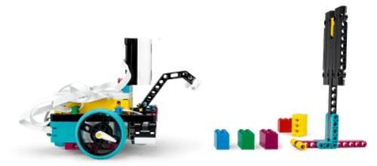
Verkefni
Ljúkið eftirfarandi kennslustundum í SPIKETM appinu
Æfingabúðir 2: Leikur með hluti
Notes:
Tasks ​
Record your team’s problem statement.
Open the SPIKE™ app. Find your lesson.
Competition Ready Unit Training Camp 2: Playing with Objects
Reflect on the skills you learned in this unit. Talk about how they will help you in the robot game.
Try it out! See if you can code your robot to attempt a mission.​
Session Tips​
The Tutorial Activities are optional but recommended if your team has minimal coding and building experience.
After a program is downloaded onto the controller, it cannot be transferred back to be opened and edited.

Slide 7


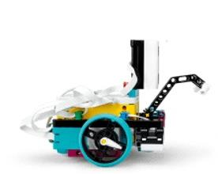
Verkefni
Reynið að forrita vélmennið til að leysa þraut.
Þið gætuð þurft að aðlaga allar viðbætur á vélmenninu fyrir þrautina sem þið ætlið að leysa
Notes:
Tasks ​
Record your team’s problem statement.
Open the SPIKE™ app. Find your lesson.
Competition Ready Unit Training Camp 2: Playing with Objects
Reflect on the skills you learned in this unit. Talk about how they will help you in the robot game.
Try it out! See if you can code your robot to attempt a mission.​
Session Tips​
The Tutorial Activities are optional but recommended if your team has minimal coding and building experience.
After a program is downloaded onto the controller, it cannot be transferred back to be opened and edited.

Slide 8

Ígrundun
Hvaða viðbótarrannsóknir eru nauðsynlegar til að velja hugmynd fyrir verkefnið?
Hvaða hluti þarf vélmennið þitt að forðast í vélmennakappleiknum?
Hvaða þrautir vill liðið þitt prófa næst?
Notes:
Session Tips:
Have the team think about how to use the attachment from the robot lesson to complete missions.

Slide 9



Deilið
Ræðið ykkar á milli hvaða þið lærðuð um vélmennið í þessum tíma.
Notes:
Share ​
Discuss the reflection questions
Get together at the mat. Share the robot skills you learned in this session.
Clean up your space.
​
Session Tips​
Have the team practice their new skills by trying to drive the robot to a model and return to home..

Slide 10

Takið til á vinnusvæðinu

Slide 11


LEGO, the LEGO logo, and the SPIKE logo are trademarks of the/sont des marques de commerce du/son marcas registradas de LEGO Group. ©2025 The LEGO Group. All rights reserved/Tous droits réservés/Todos los derechos reservados. FIRST®, the FIRST® logo, and FIRST® AGE™ are trademarks of For Inspiration and Recognition of Science and Technology (FIRST). LEGO® is a registered trademark of the LEGO Group. FIRST® LEGO® League and UNEARTHED™ are jointly held trademarks of FIRST and the LEGO Group. ©2025 FIRST and the LEGO Group. All rights reserved.

