Slide 1
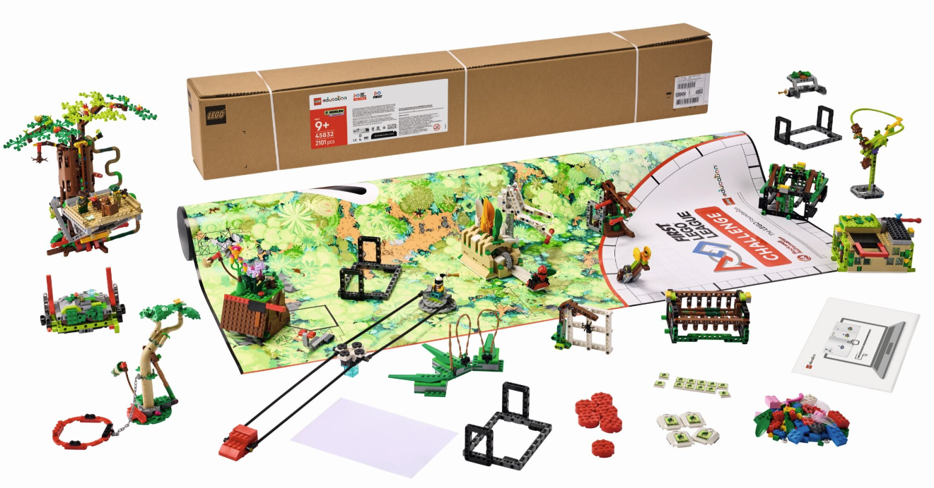


INTRODUCTION
Let’s Get Started

Slide 2



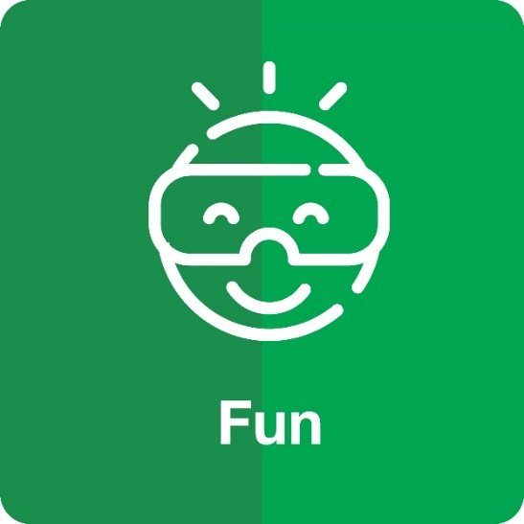


Core Values
Notes:
FIRST® Core Values ​
The FIRST Core Values are fundamental to FIRST and unique to its programs. They emphasize friendly collaboration, respect for the contributions of others, teamwork, learning, and community involvement and are part of our commitment to fostering, cultivating, and preserving a culture of equity, diversity, and inclusion.
Our community expresses the FIRST philosophies of Gracious Professionalism® and Coopertition® through the FIRST Core Values.

Slide 3
Overview – Core Values
Demonstrate FIRST ® Core Values in everything you do. Your team will be evaluated during the robot game and the judging session.
Your team will:
Apply teamwork and discovery to explore the challenge.
Innovate with new ideas about your robot and project.
Show how your team and your solutions will have an impact and be inclusive!
Celebrate by having fun in everything you do!
Notes:
Challenge slide

Slide 4
Overview – Innovation Project
Your team will prepare a live, engaging presentation to explain the work you have done on your innovation project.
Your team will:
Identify and research a problem.
Design a new solution or improve an existing one based on your selected idea, brainstorming, and plan.
Create a model, drawing, or prototype.
Iterate on your solution by sharing it with others and collecting feedback.
Communicate your solution’s potential impact.
Notes:
Challenge slide

Slide 5
Overview – Robot Design
Your team will prepare a short explanation on your robot design, programs, and strategy.
Your team will:
Identify your mission strategy.
Design your robot and programs and create an effective plan.
Create your robot and programming solution.
Iterate, test, and improve your robot and program.
Communicate your robot design process and everyone’s contributions.
Notes:
Challenge slide

Slide 6
Overview – Robot Game
Your team will have three 2.5-minute matches to complete as many missions as possible.
Your team will:
Build the mission models and set up the field mat.
Review the missions and rules.
Design and build a robot.
Explore building and coding skills while practicing with your robot on the mat.
Compete at an event!
Notes:
Challenge slide

Slide 7
UNEARTHEDTM
BIOGLOWTM
Visit the FIRST LEGO League YouTube Channel for more videos. Click "Play" to view the 2026-2027 BIOGLOWTM Season Playlist.​

Slide 8

Team Journey
Design Your Innovation Project
Design Your Robot
Use the Engineering Design Process and Core Values
Notes:
Challenge slide

Slide 9

Team Journey
Create Your Innovation Project Solution
Create Your Robot Solution
Iterate Your Solutions
Communicate Your Solutions at Event
Compete in Robot Game
Receive Feedback to Improve
Have Fun and Celebrate
Notes:
Challenge slide

Slide 10

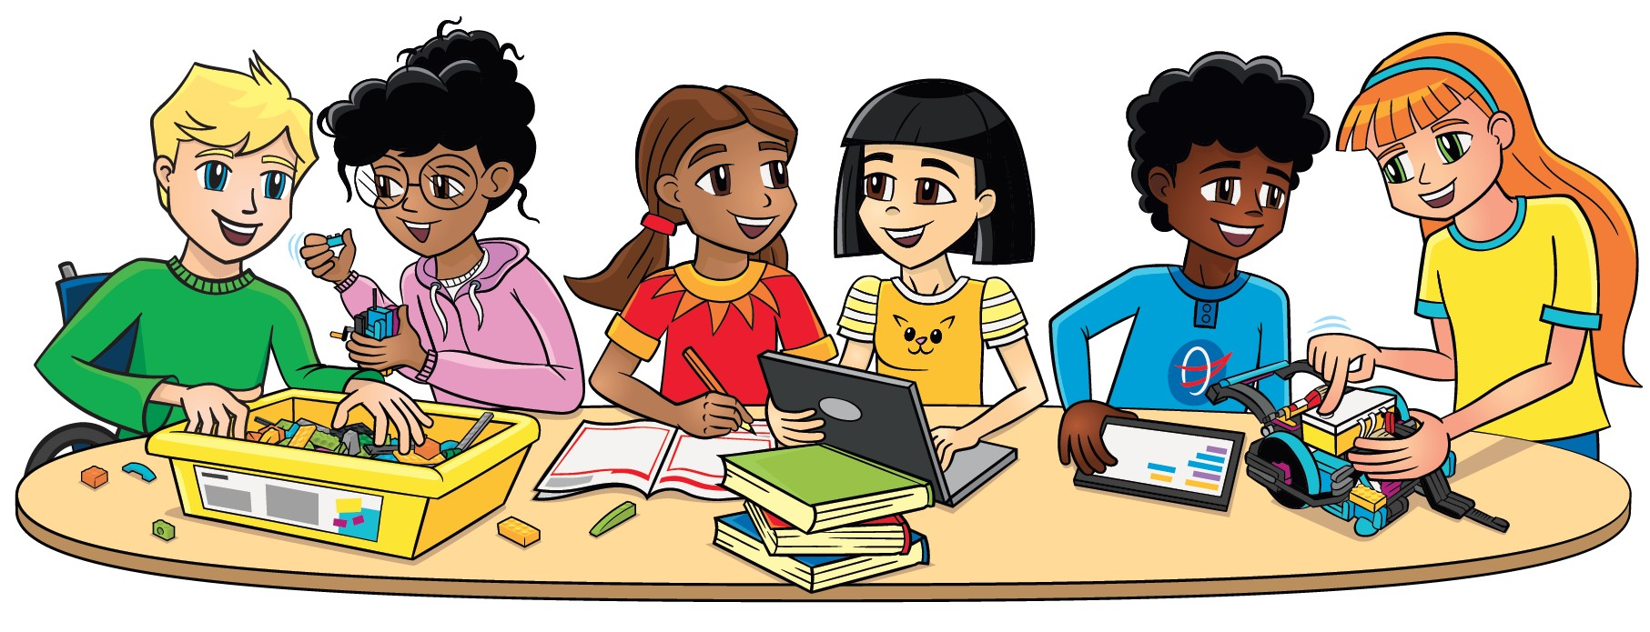
Team Roles
Researcher
Creative Designer
Communicator
Investigates ideas and finds relevant research from different sources to inform the team’s
decision-making.
Creates innovative designs for solutions to be discussed with the
team.
Concentrates on how to
Communicate the team’s work. Writes scripts and prepares presentations.
Team Captain
Project Manager
Shares team progress with facilitator. Ensures session tasks are completed.
Focuses on time management and preparing for the event.
Notes:
Challenge slide

Slide 11
Team Roles
Material Manager
Builder
Mission Strategist
Coder
Gathers and returns materials needed for the session.
Assembles the LEGO mission models following the building
instructions and builds your robot.
Analyzes the Robot Game Rulebook and leads team strategy discussions on which missions to attempt.
Operates the device and creates the programs in the app.
Notes:
Challenge slide

Slide 12
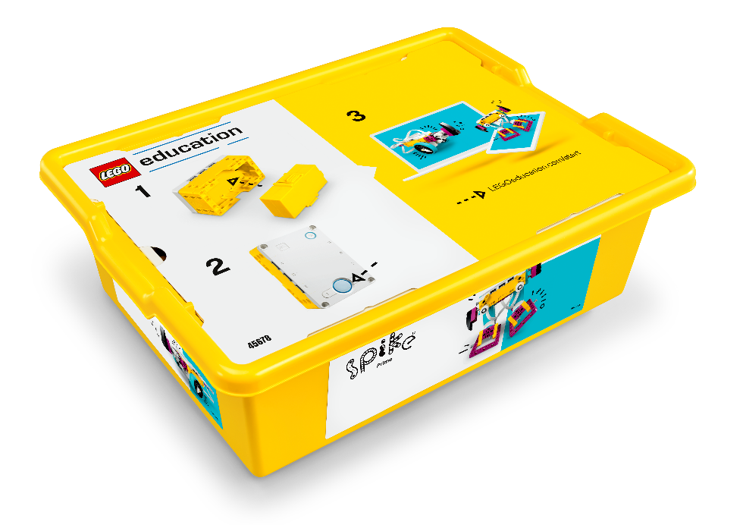

Materials Needed
LEGO® Education SPIKETM Prime Set
Electronic Device
Note: Other LEGO® Education sets such as MINDSTORMS ® and Robot Inventor are also allowed.
Notes:
Challenge slide

Slide 13
Materials Needed
BIOGLOWTM Challenge Set
The Challenge Set comes in a box that contains the mission models, challenge mat, and 3M™ Dual Lock™ Reclosable Fasteners, coach pins, and season tiles for the team members. The team should build the models very carefully using the building instructions.
Notes:
Challenge slide

Slide 14
Materials Needed
Challenge Mat and Table
Set up a table with the challenge mat in your classroom or meeting space.
Teams can practice on the mat by placing it on the floor.
However, robot game matches at official events will be played on a table complete with sidewalls.
Instructions to build a table can be found on the Season Resources page.
Notes:
Challenge slide

Slide 15
Technology Connections
Drones
Plant Study Tools
Animal Monitoring Tools
Conservation Tools
Notes:
Challenge slide

Slide 16
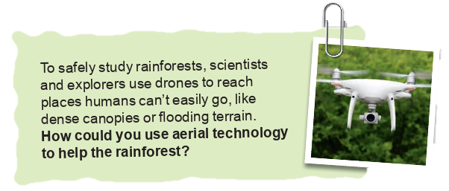
Project Sparks
How could you use aerial technology to help the rainforest?
To safely study rainforests, scientists and explorers use drones to reach places humans can’t easily go, like dense canopies or flooding terrain.

Slide 17
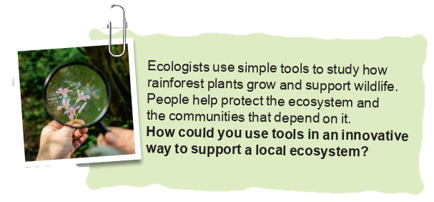
Project Sparks
How could you use tools in an innovative way to support a local ecosystem?
Ecologists use simple tools to study how rainforest plants grow and support wildlife. People help protect the ecosystem and the communities that depend on it.

Slide 18
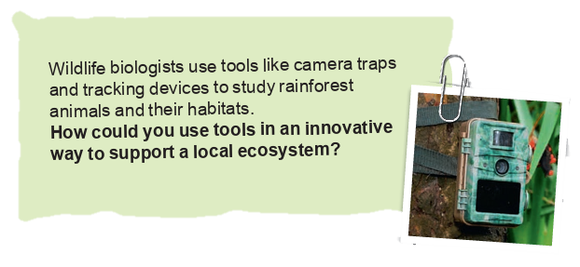
Project Sparks
How could you use tools in an innovative way to support a local ecosystem?
Wildlife biologists use tools like camera traps and tracking devices to study rainforest animals and their habitats.

Slide 19
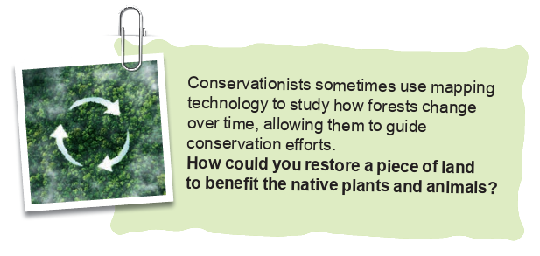
Project Sparks
How could you restore a piece of land to benefit the native plants and animals?
Conservationists sometimes use mapping technology to study how forests change over time, allowing them to guide conservation efforts.

Slide 20
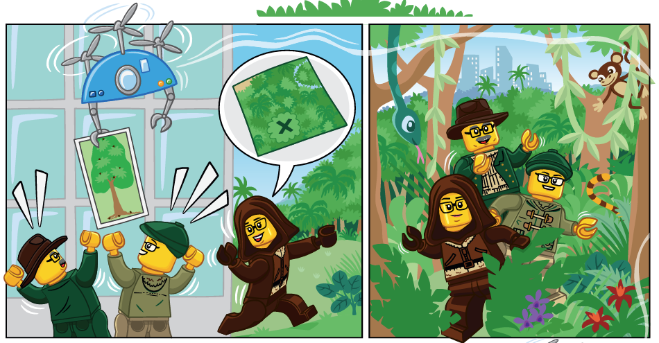
Story

Slide 21
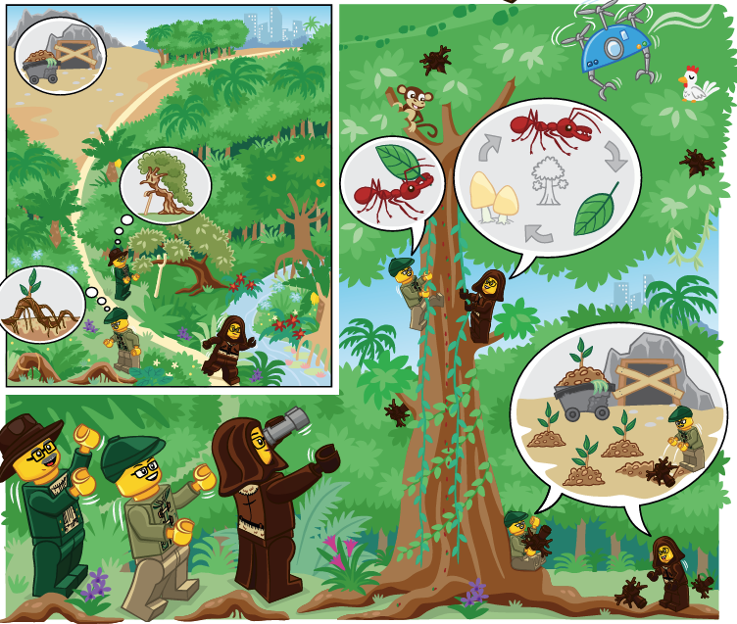
Story

Slide 22

Clean Up

Slide 23

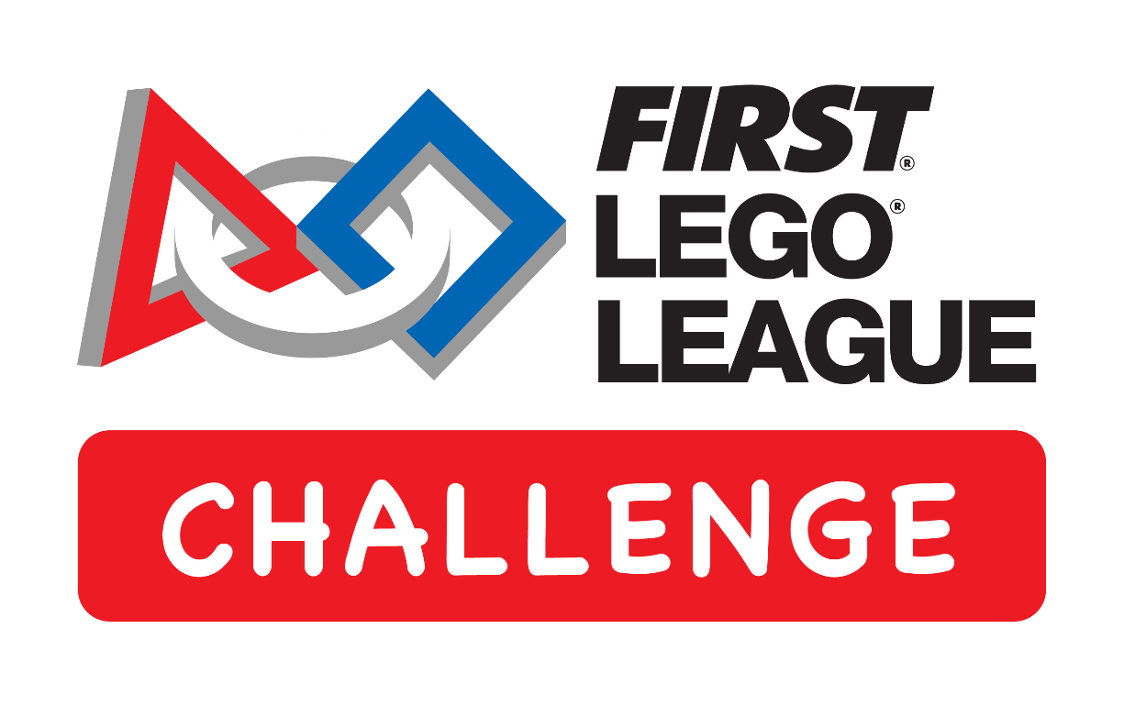
LEGO, the LEGO logo, the Minifigure, LEGO Education, the LEGO Education logo, and the SPIKE logo are trademarks of the/sont des marques de commerce du/son marcas registradas de LEGO Group. ©2026 The LEGO Group. All rights reserved/Tous droits réservés/Todos los derechos reservados. FIRST®, the FIRST® logo, and FIRST® CANOPY™ are trademarks of For Inspiration and Recognition of Science and Technology (FIRST). LEGO® is a registered trademark of the LEGO Group. FIRST® LEGO® League and BIOGLOW™ are jointly held trademarks of FIRST and the LEGO Group. ©2026 FIRST and the LEGO Group. All rights reserved.

